Slide 1
Rendering 3D objects onto 2D screens
By Rajas Paranjpe
MVC Semester 1 Project (2024)

Slide 2
Who likes video games?

Slide 3

Who likes making video games?

Slide 4
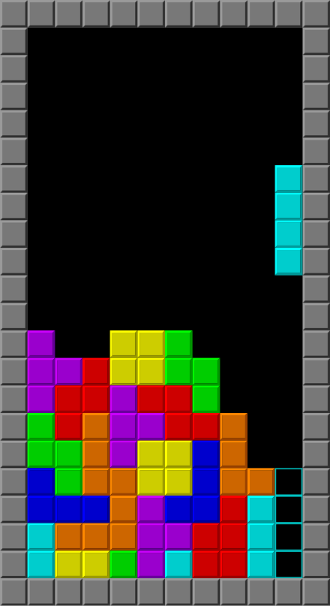


Video Games First Group

Slide 5
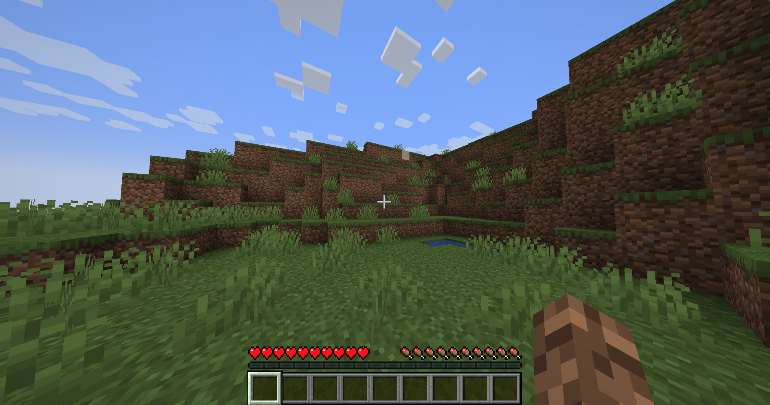

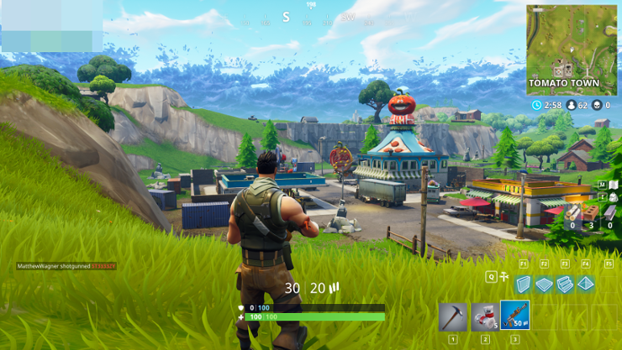
Video Games Second Group

Slide 6
What differentiates the two groups?

Slide 7
How could you make your own 3D video game without using an existing 3D rendering library?

Slide 8

What is a screen?

Slide 9
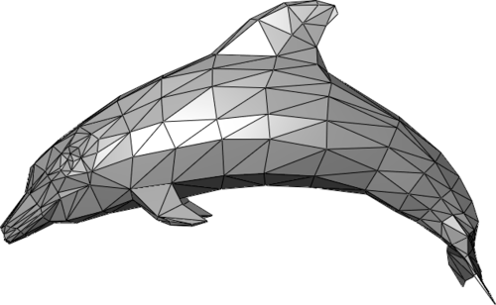
What exactly are “3D objects”?

Slide 10
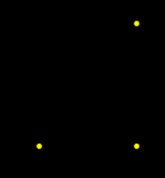
Getting 2D Triangles from 3D Triangles

Slide 11
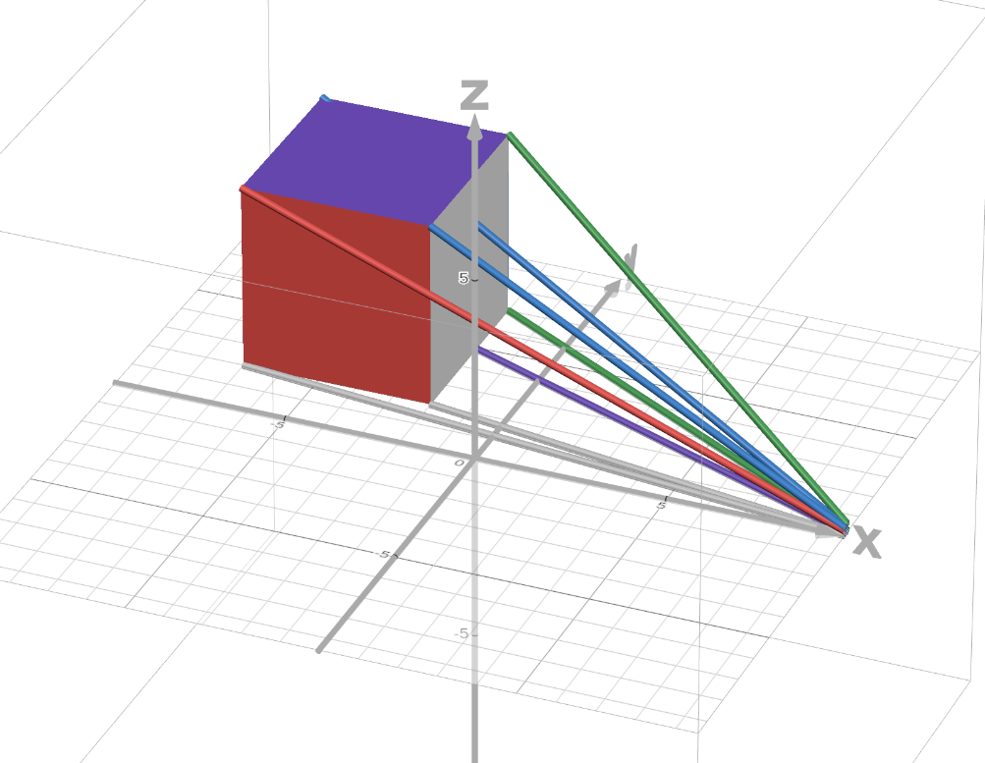
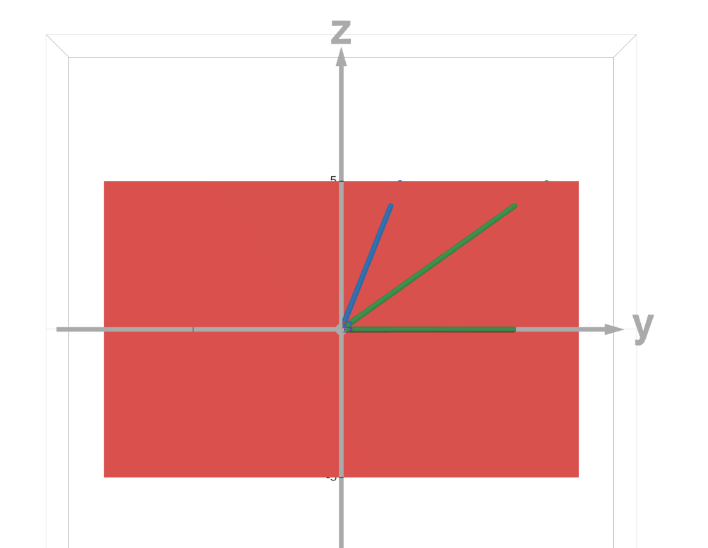
Getting a screen (2D) position from a point in 3D space - Desmos Link

Slide 12
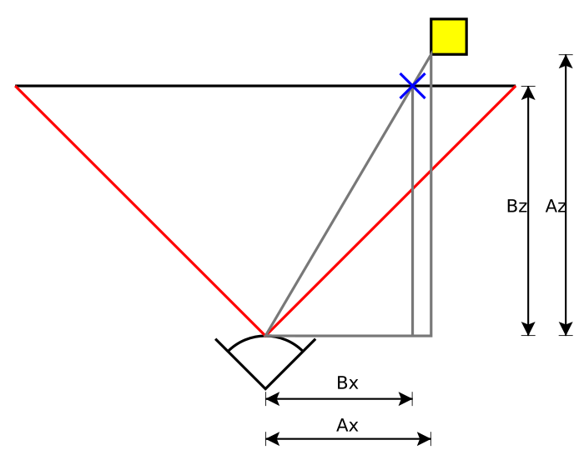
A simple top view diagram - Wikipedia

Slide 13
Overlapping Triangles

Slide 14
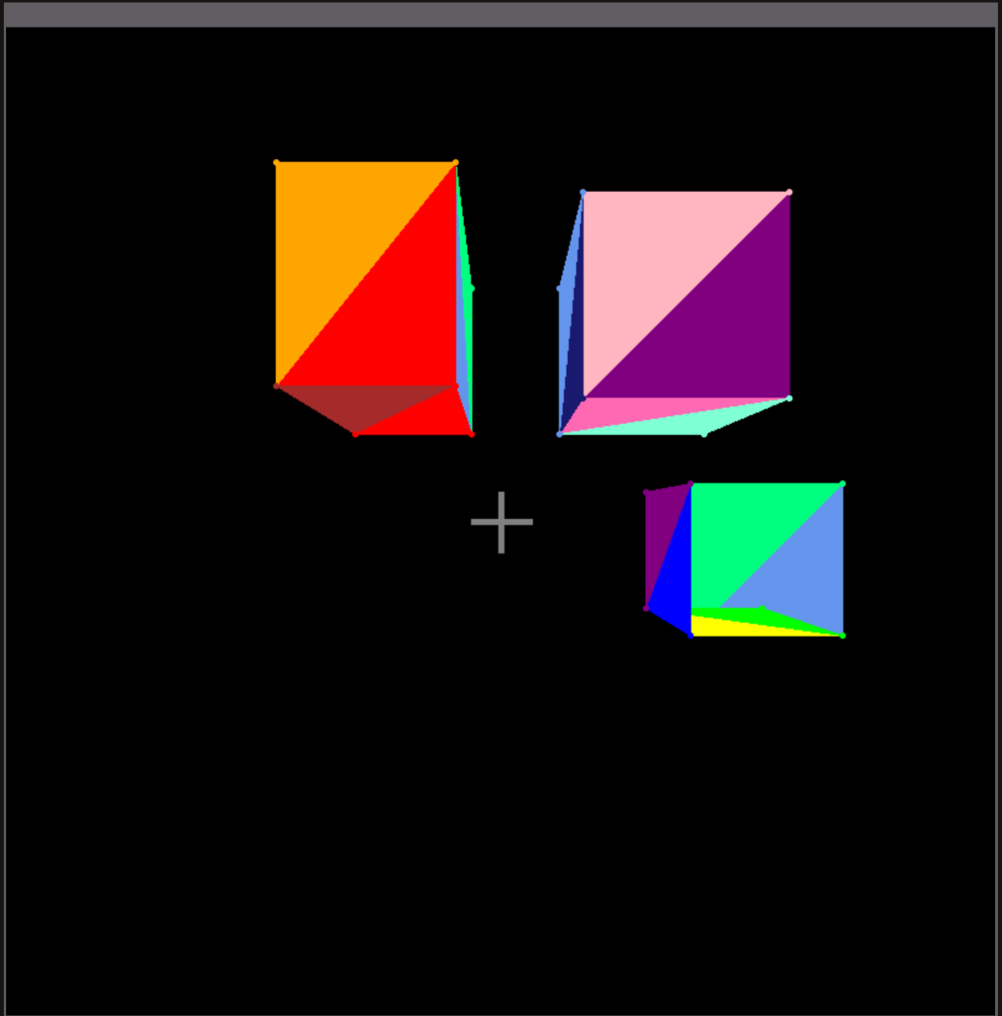
Product - Demo of drawing rectangular prisms onto screen with perspective view

Slide 15
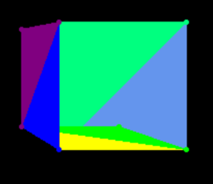
What’s wrong with this rectangular prism?

Slide 16
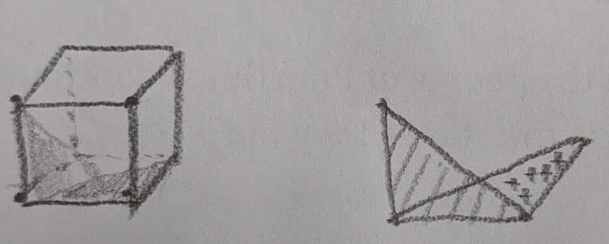
What’s wrong with this rectangular prism?

Slide 17
Questions?

Slide 18
Further things to learn if you’re interested
How GPUs significantly speed up rendering
How ray tracing works
How lighting works
Optimizing code for 3D games
How 3D textures are stored, loaded, and rendered
How are spheres and other curved surfaces converted into triangles?
What other related applications are which also include a LOT of mathematics, such as rendering movies?
How curved screens change things, or how VR introduces new challenges to rendering.
Learning linear algebra probably helps a TON for doing the math behind 3D rendering. I have not taken a linear algebra course but now I think it will be very useful to learn.
How are 2D triangles drawn is pixels onto the screen?

